Slide 1
ECO102: Introduction to Macroeconomics
Lecturer: Addrita Shams
Week 02, Lecture 03
Chapter 22: Monitoring jobs and inflation

Slide 2
Population Labor Force Categories
The population divides into two broad groups: the working-age population and others who are too young to work or who live in institutions and are unable to work.
The working-age population is the total number of people aged 16 years and over who are not in jail, hospital, or some other form of institutional care.
The Census Bureau divides the working-age population into two groups: those in the labor force and those not in the labor force.
It also divides the labor force into two groups: the employed and the unemployed. So the labor force is the sum of the employed and the unemployed.
To be counted as employed in the Current Population Survey, a person must have either a full-time job or a part-time job.

Slide 3
Unemployment
To be counted as unemployed, a person must be available for work and must be in one of three categories:
1. Without work but has made specific efforts to find a job within the previous four weeks
2. Waiting to be called back to a job from which he or she has been laid off
3. Waiting to start a new job within 30 days
Why Unemployment Is a Problem?
Unemployment is a serious personal and social economic problem for two main reasons. It results in
■ Lost incomes and production
■ Lost human capital

Slide 4
Labor Market Indicators
Three Labor Market Indicators
The Census Bureau calculates three indicators of the state of the labor market. They are-
■ The unemployment rate
■ The employment-to-population ratio
■ The labor force participation rate
The Unemployment Rate The amount of unemployment is an indicator of the extent to which people who want jobs can’t find them. The unemployment rate is the percentage of the people in the labor force who are unemployed. That is,
Unemployment Rate= (Number of people unemployed/ Labor Force)* 100
Labor Force= Number of people employed+ Number of people unemployed

Slide 5
Labor Market Indicators (Contd.)
The Employment-to-Population Ratio The number of people of working age who have jobs is an indicator of both the availability of jobs and the degree of match between people’s skills and jobs. The employment-to-population ratio is the percentage of people of working age who have jobs.
Employment to population Ratio= (Number of people employed/Working ago population)*100
The Labor Force Participation Rate The number of people in the labor force is an indicator of the willingness of people of working age to take jobs. The labor force participation rate is the percentage of the working-age population who are members of the labor force.
Labor force participation rate= (Labor Force/ Working age population)*100

Slide 6
Different Types of Unemployment
There is always someone without a job who is searching for one, so there is always some unemployment.
The key reason is that the economy is a complex mechanism that is always changing—it experiences frictions, structural change, and cycles.
There are four types of unemployment:
Frictional Unemployment
Structural Unemployment
Cyclical Unemployment
Natural Unemployment

Slide 7
Frictional Unemployment
There is an unending flow of people into and out of the labor force as people move through the stages of life—from being in school to finding a job, to working, perhaps to becoming unhappy with a job and looking for a new one, and finally, to retiring from full-time work.
There is also an unending process of job creation and job destruction as new firms are born, firms expand or contract, and some firms fail and go out of business.
The unemployment that arises from the normal labor turnover—from people entering and leaving the labor force and from the ongoing creation and destruction of jobs—is called frictional unemployment.
Frictional unemployment is a permanent and healthy phenomenon in a dynamic, growing economy.

Slide 8
Structural Unemployment and Cyclical Unemployment
Structural unemployment : The unemployment that arises when changes in technology or international competition change the skills needed to perform jobs or change the locations of jobs is called structural unemployment.
Structural unemployment usually lasts longer than frictional unemployment because workers must retrain and possibly relocate to find a job.
Cyclical Unemployment:
The higher than normal unemployment at a business cycle trough and the lower than normal unemployment at a business cycle peak is called cyclical unemployment.
A worker who is laid off because the economy is in a recession and who gets rehired some months later when the expansion begins has experienced cyclical unemployment.

Slide 9
Natural Unemployment
Natural unemployment is the unemployment that arises from frictions and structural change when there is no cyclical unemployment—when all the unemployment is frictional and structural.
Natural unemployment as a percentage of the labor force is called the natural unemployment rate.
Full employment is defined as a situation in which the unemployment rate equals the natural unemployment rate.
The natural unemployment rate is influenced by many factors but the most important ones are
■ The age distribution of the population
■ The scale of structural change
■ The real wage rate
■ Unemployment benefits

Slide 10
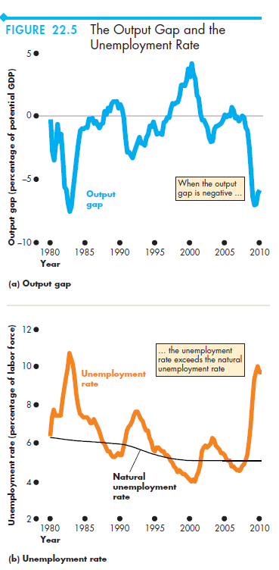
Real GDP and Unemployment Over the Cycle
The quantity of real GDP at full employment is potential GDP.
Over the business cycle, real GDP fluctuates around potential GDP.
The gap between real GDP and potential GDP is called the output gap.
As the output gap fluctuates over the business cycle, the unemployment rate fluctuates around the natural unemployment rate.
When the economy is at full employment, the unemployment rate equals the natural unemployment rate and real GDP equals potential GDP so the output gap is zero.
When the unemployment rate is less than the natural unemployment rate, real GDP is greater than potential GDP and the output gap is positive.
And when the unemployment rate is greater than the natural unemployment rate, real GDP is less than potential GDP and the output gap is negative.

